Slide 1


iHeartRadio
iHeartRadio is an internet radio broadcast system that owned by iHeartMedia.
iHeartRadio is founded in 2008.
iHeartRadio is available in the United States, New Zealand, Australia, Mexico and Canada.
By zahirul islam

Slide 2


iHeartRadio Functions
iHeartRadio functions are:
>Favorites > Live radio >Create Station
>Personalities >Playlists >Search
>Genre >Albums > Music Videos
>Singles on Demand >Entertainment

Slide 3

How iHeartRadio Work
User can connect iHeartRadio for Auto by using Bluetooth Audio, an Aux cable, pre-installed app or downloaded app to stream iHeartRadio in the vehicle.
>To play iHeartRadio in the vehicle user must link iHeartRadio account
>Make sure phone’s Bluetooth connection is paired with the vehicle
>Phone’s internet services are connected
>To begin listening to iHeartRadio press the Apps button on HMI
>Select the iHeartRadio icon
>Then app will launch to iHeartRadio home screen
>Select the live radio or any station to begin streaming the broadcast
iHeart Radio has free, plus, family and all access plan that user require to pay

Slide 4
How We Test iHeartRadio
Test Name | Spec ID | Pre-condition | Description | Test Steps | Expected Result | Actual Result | Status
iHeartRadio 1 | 1.1.1 | System On iHeartRadio account iHeartRadio app iPhone 11 with internet service | Verifying user able to play Live Radio by Near You radio station 102.7 | Sign into iHeartRadio account Connect Phone’s Bluetooth and internet with vehicle Select Audio Apps on HMI. Select “iHeartRadio” App Select “Live Radio” icon Select “Near You” icon Select 102.7 station | User should be able to listen live radio by near you station 102.7 | User able to listen live radio by near you station 102.7 | Pass
iHeartRadio 2 | 1.1.2 | System On iHeartRadio account iHeartRadio app iPhone 11 with internet service | Verifying user able to search the artists by their name to listen their songs | Sign into iHeartRadio account Connect Phone’s Bluetooth and internet with vehicle Select Audio Apps on HMI Select “iHeartRadio” App Select the Magnifying glass icon Select the search box Enter the Artists name Select ok Select Artists Select the song | User should be able to search the artists name and listen to their songs | User able to search the artists name and listen to their songs | Pass
iHeartRadio 3 | 1.1.3 | System On iHeartRadio account iHeartRadio app iPhone 11 with internet service | Verifying user able to create station of their favorite music | Sign into iHeartRadio account Connect Phone’s Bluetooth and internet with vehicle Select Audio Apps on HMI Select “iHeartRadio” App Select “Create Station” icon Choose a “Genre” Select “Pop” | User should be able to create station of Pop music | User not able to create station of Pop music | Fail

Slide 5
How We Test iHeartRadio
Test Name: iHeartRadio 1
Spec ID: 1.1.1
Pre-condition: 1. System On 2. Valid iHeartRadio account 3. iHeartRadio app 4. IPhone 11 with internet service
Description: Verifying user able to play Live Radio by Near You radio station 102.7
Test Steps: 1. Sign into iHeartRadio account 2. Connect Phone’s Bluetooth and internet with vehicle 3. Select Audio Apps on HMI 4. Select “iHeartRadio” App 5.Select “Live Radio” icon 6. Select “Near You” icon 7. Select 102.7 station
Expected Result: User should be able to listen live radio by near you station 102.7
Actual Result: User able to listen live radio by near you station 102.7
Status: Pass

Slide 6
How We Test iHeartRadio
Test Name: iHeartRadio 2
Spec ID: 1.1.2
Pre-condition: 1. System On 2. Valid iHeartRadio account 3. iHeartRadio app 4. IPhone11 with internet service
Description: Verifying user able to search the artists by their name to listen their songs
Test Steps: 1. Sign into iHeartRadio account 2. Connect Phone’s Bluetooth and internet with vehicle 3. Select Audio Apps on HMI 4. Select “iHeartRadio” App 5. Select the Magnifying glass icon 6. Select the search box 7. Enter the Artists name 8. Select ok 9. Select Artists 10. Select the song
Expected Result: User should be able to search the artists name and listen to their songs
Actual Result: User able to search the artists name and listen to their songs
Status: Pass

Slide 7
How We Test iHeartRadio
Test Name: iHeartRadio 3
Spec ID: 1.1.3
Pre-condition: 1. System On 2. Valid iHeartRadio account 3. iHeartRadio app 4. Iphone 11 with internet service
Description: Verifying user able to create station of their favorite music
Test Steps: 1. Sign into iHeartRadio account 2. Connect Phone’s Bluetooth and internet with vehicle 3. Select Audio Apps on HMI 4. Select “iHeartRadio” App 5. Select “Create Station” icon 6. Choose a “Genre” 7. Select “Pop” music
Expected Result: User should be able to create station of Pop music
Actual Result: User not able to create station of Pop music
Status: Fail

Slide 8
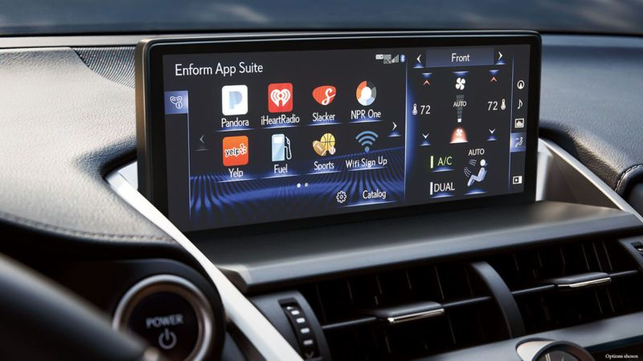
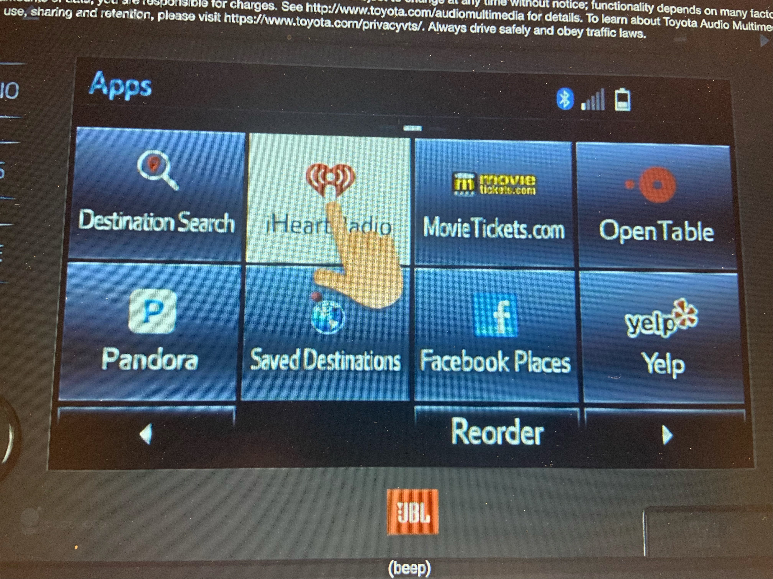
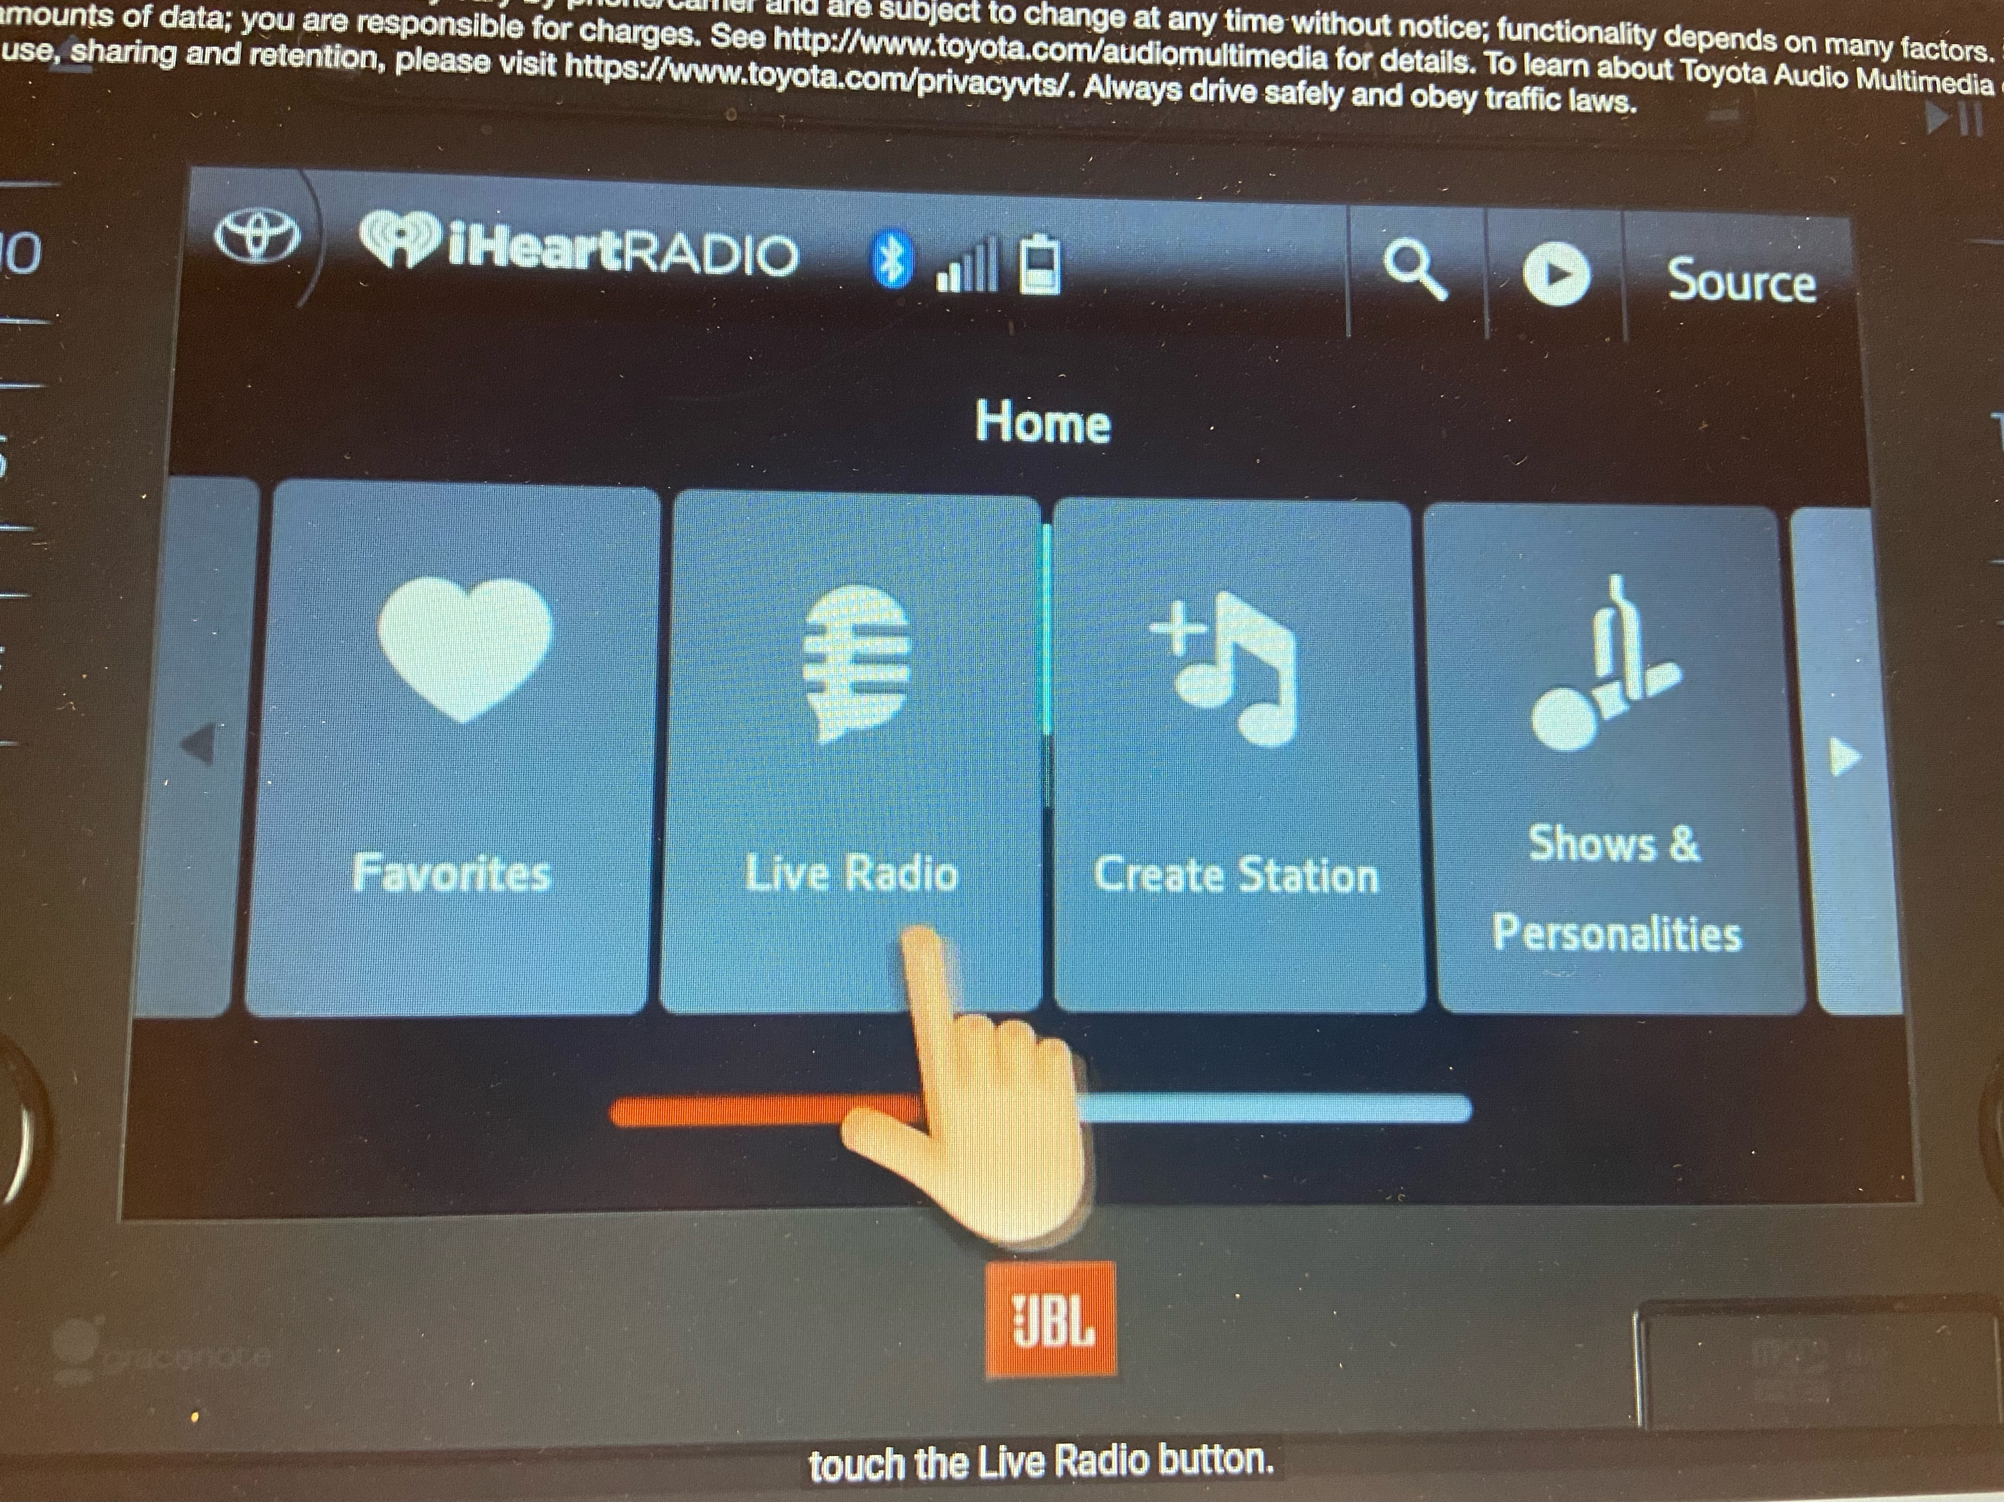
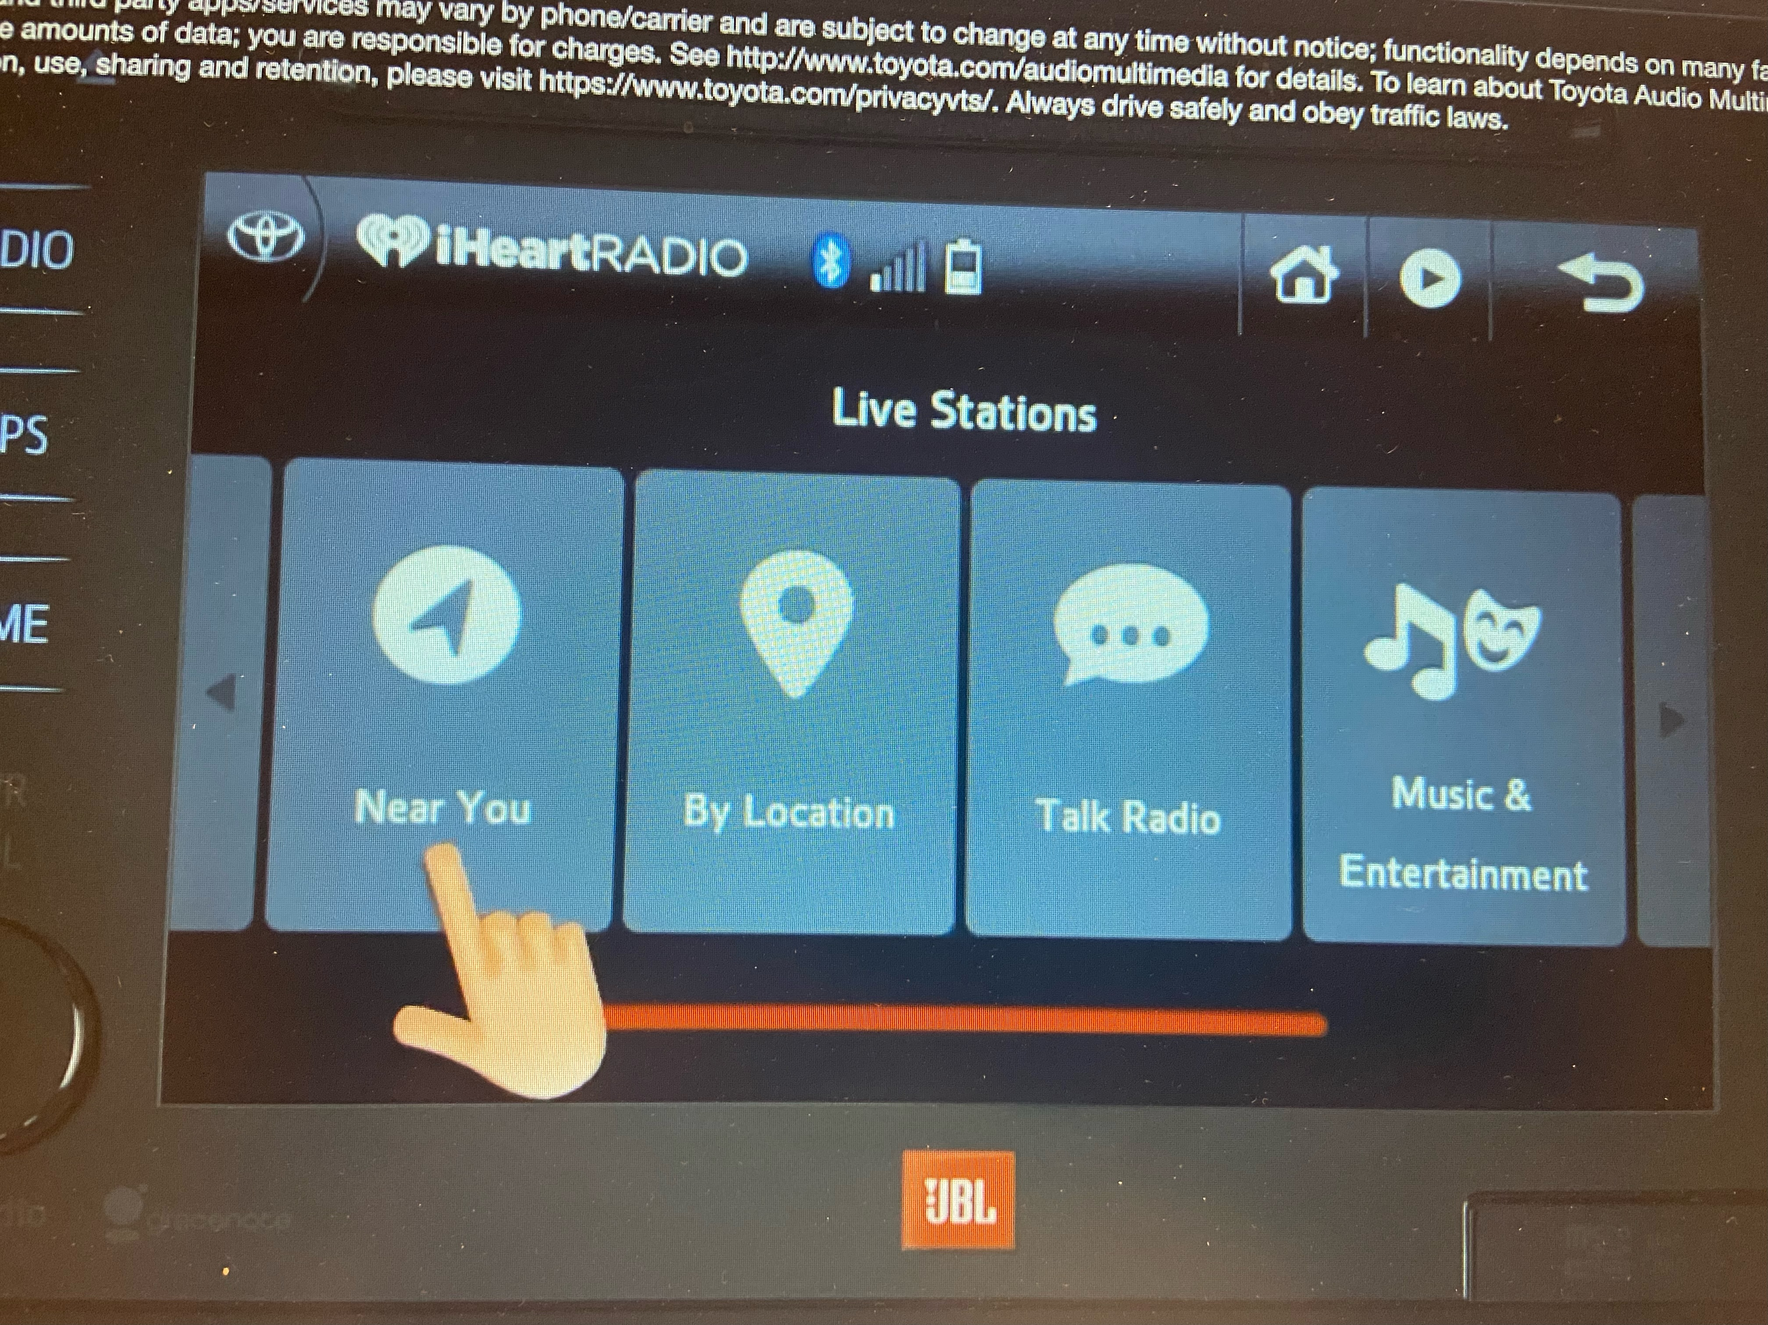
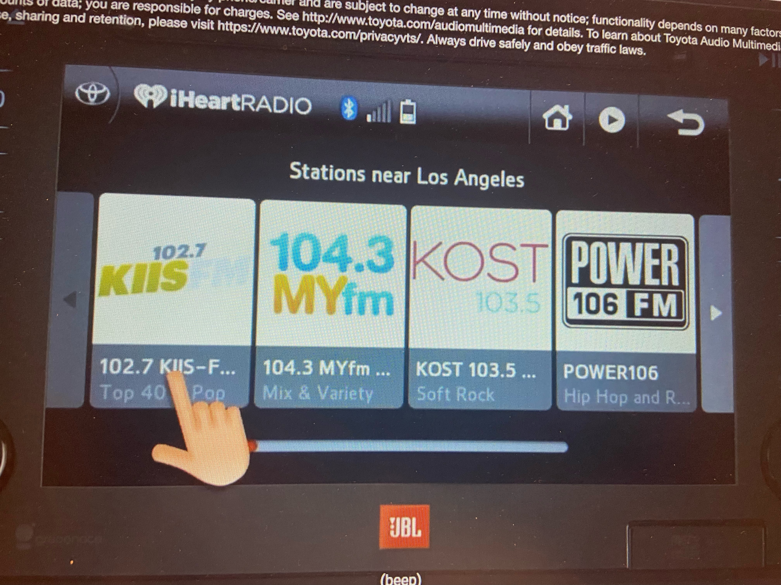
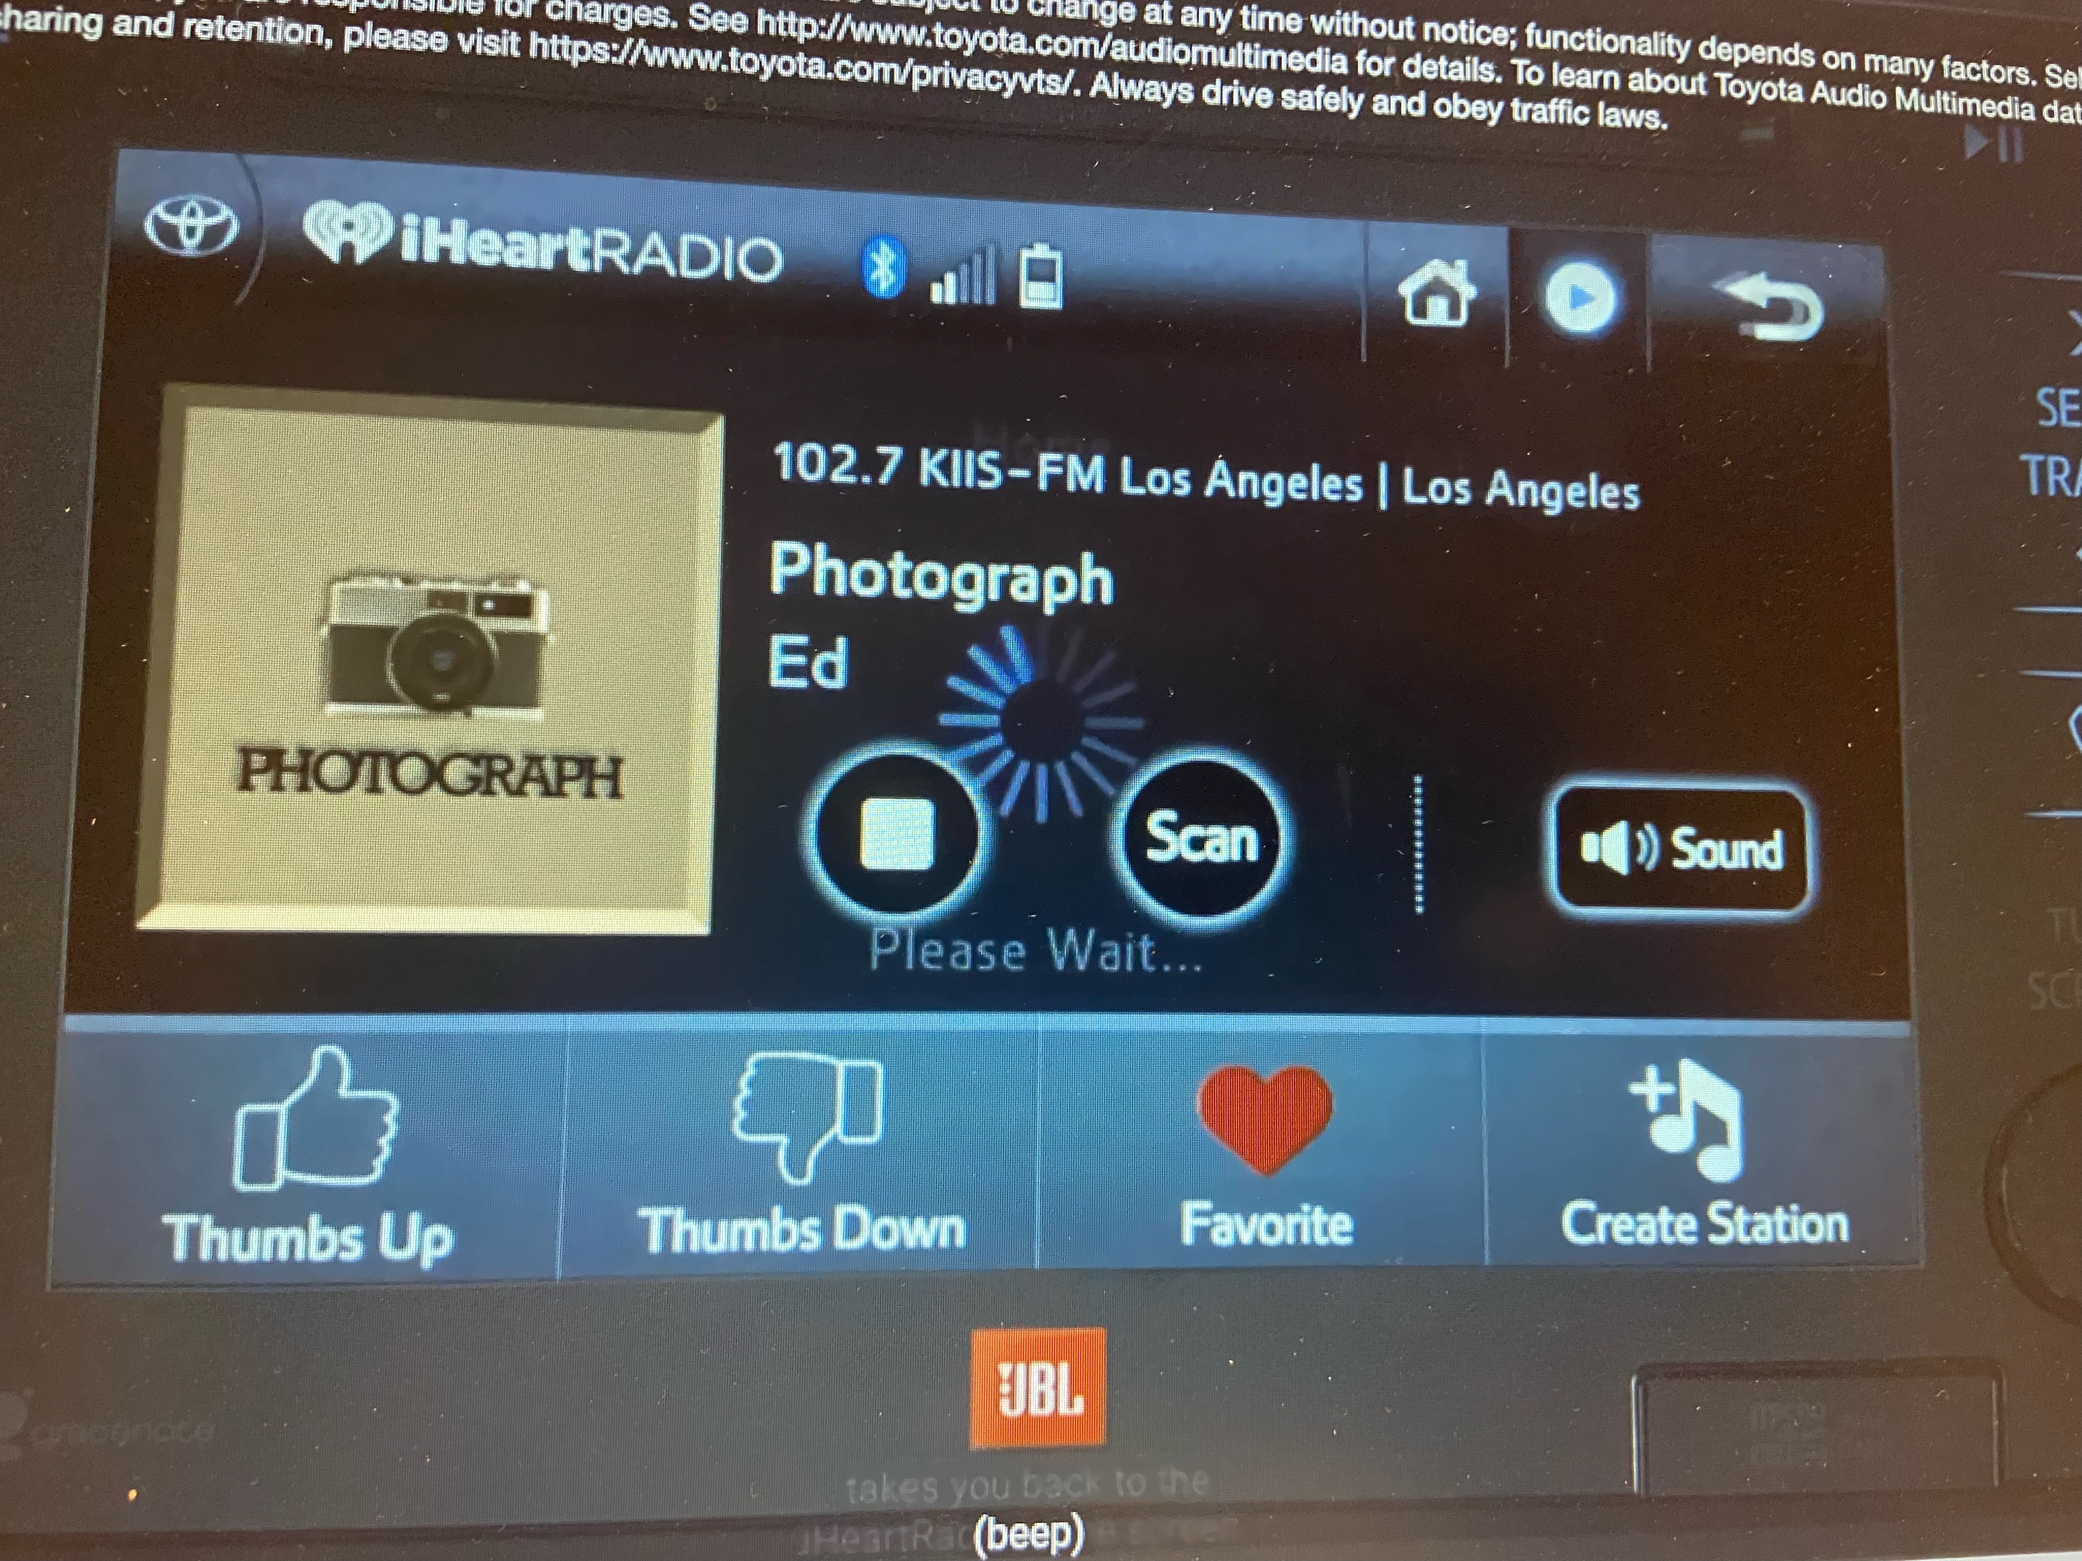
How We Test iHeartRadio...

Slide 9

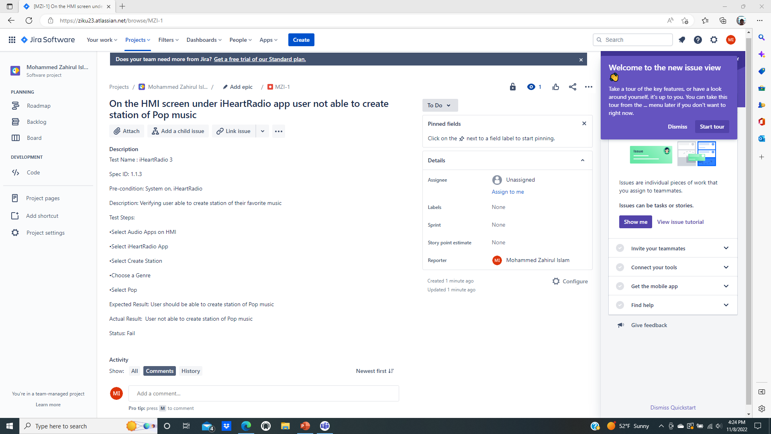
Bug/Defect of iHeartRadio

Slide 10
Bug/Defect of iHeartRadio
Summary: On the HMI screen under iHeartRadio app user not able to create station of Pop music Priority: Low Status: New Description: Test name: iHeartRadio 3 Spec ID: 1.1.3 Pre-condition: 1. System On 2. Valid iHeartRadio account 3. iHeartRadio app 4. iPhone 11 with internet service Test Description:Verifying user able to create station of their favorite music Test Steps: 1. Sign into iHeartRadio account 2. Connect phone’s Bluetooth and internet with vehicle 3. Select audio apps on HMI 4. Select “iHeartRadio” app 5. Select “Create Station” icon 6. Choose a Genre 7. Select Pop music Expected Result:User should be able to create station of Pop music Actual Result:User not able to create station of Pop music Reproducible rate: 90% Evidence: See the attachment Environment: Vehicle, iPhone 11 Model: Toyota Highlander 2018 Reporter: Zahirul Islam, abc@gmail.com Date and time: November 10, 2022 @ 8:00 pm

Slide 11

Important of iHeartRadio
User can enhance the knowledge about current, international and day to day affairs by listening to iHeartRadio and can customized radio station, album or song based on individual interest.
iHeartRadio is the best sources for entertainment, news and information that combine America’s favorite radio stations, podcast and music together in one app.
iHeartRadio is the best radio broadcast because it has live music, live event and local that focused on listener and connected anywhere in the America.

Slide 12

iHeartRadio
Thank you!

